Slide 1
Maker’s university – by intel’s makers community class 3
Gil Tal.
Jan 2020

Slide 3
Class 3 agenda:
Choose your team … ☺
Functional specifications
Arcade’s team – Kick starting
Project specifications
Pickup the right devices
Your thoughts … ☺
Drone’s team – Kick starting
Same process as Arcade’s team
Operating C++

Slide 4
Functional specifications document
Formal document describing a product
Product overview
Technical specifications
Functional Requirements
Components
Costs
Appearance
User interface

Slide 5
Operating c++
Struct in C and typedef
Class in C++
Private\Protected\Public
Inheritance
Constructor
Destructor
Function override
Static Instance VS dynamic allocation (. Vs ->)
Function overloading
Default parameters
Parameters by value\reference\pointer
Arrays
Casting
Extern

Slide 6
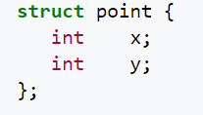
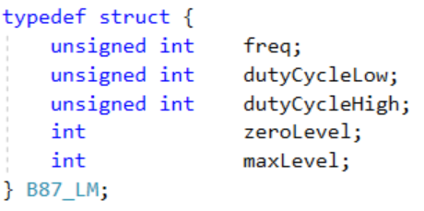
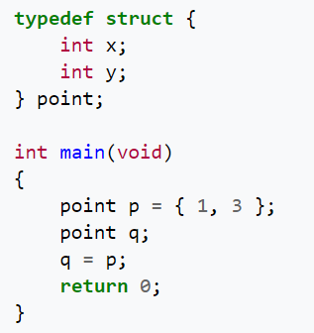
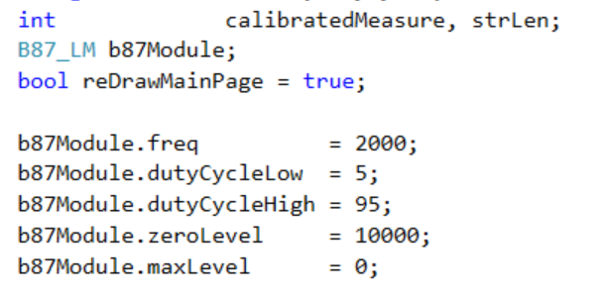
Struct in C and typedef
Composite data type
Grouped list of variables under one name
Accessed via a single pointer or by the struct declared name
Example:

Slide 7
Class in c++
A user-defined type or data structure
Has data and functions (also called member variables and member functions)
Can be accessed as with struct
Variables members and functions can be:
Public
Private
Protected

Slide 8
Temp
AAA
BBB

